Slide 1


PY-EXPO
2K24
Team ID:T028
Team Name: Pypros
Genius innovation leaves behind a legacy...
PYEXPO 2K24

Slide 2
PS Code: PY83
Problem Statement:
IoT-enabled Smart Urban Farming System
02
PYEXPO 2K24

Slide 3
Hardware used: Sensor Technology:- soil moisture sensor Temperature and humidity sensor
Solution
Our urban farming solution uses IoT sensors to monitor environmental conditions and optimize crop growth.
With automated irrigation, our urban farming solution promotes sustainable agriculture.
Our mobile app allows remote monitoring and control for farmers, ensuring a more efficient and environmentally friendly farming future.
Technology Stack
Internet Of Things(IoT) platforms
Microcontroller Platforms
Actuator Technology
Open Source Software
Hardware-Arduino
03
PYEXPO 2K24

Slide 4
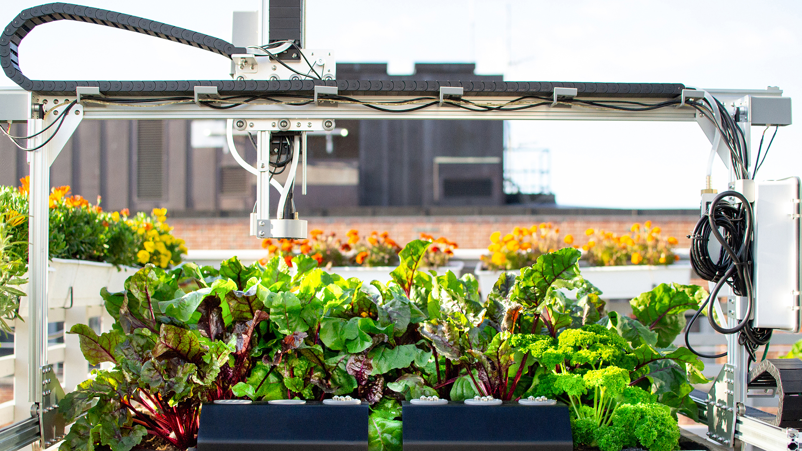
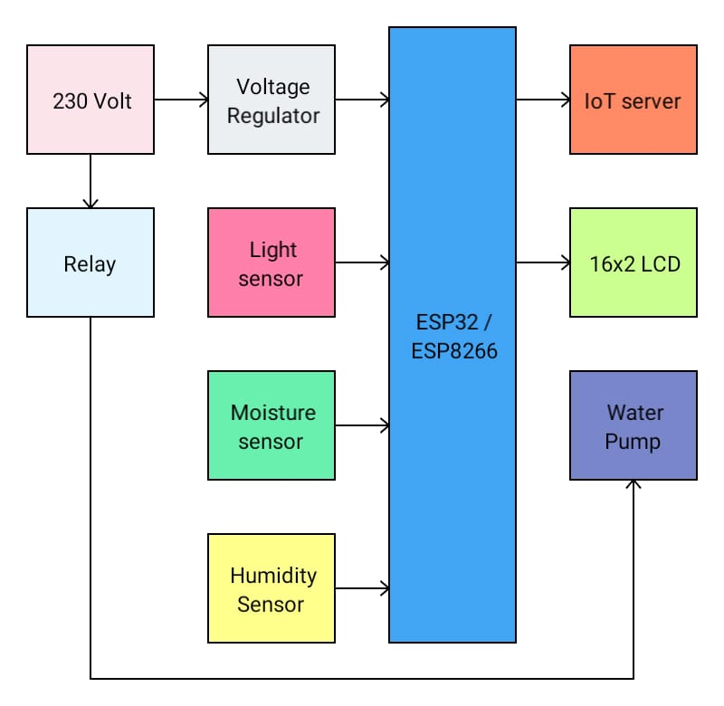
Flowchart
ARDUINO UNO
04
PYEXPO 2K24

Slide 5
Team Member Details:
Sujithra M -23AIB43
Priya Dharshini K -23AIB08
Nihar H -23AIB01
Sanjay G -23AIB22
Manoj M -23ME27
05
PYEXPO 2K24

Slide 6

Thank You
Any Queries?
PYEXPO 2K24

